Slide 1
How We Hear: Men VS Women
Scientific Differences
As a female sound engineer for the last 14 years, I have always noticed a difference in how and what I hear compared to men. It has been a discussion among lady engineers for years, and I have chosen to pursue an academic study of the subject.
In this Discussion we will cover not jus the science of how we hear differently, but also the application in everyday mixing from IEM to FOH. Understanding how to use all the tools at your disposal is an incredible advantage over many of those around you, and understanding how men, women and all those in between hear will set you apart from the crowd. Effectiveness comes from consistency.
While in this discussion I will be using the term Male and Female as this is how science refers to the sexes assigned at birth, please know that while I use these terms I am including all sexes and genders who identify thusly, and those who do not. Science does not have any studies on Trans-gendered hearing, and thus, I am unable to compile correlating data for this study. I would love nothing more than for there to be numerous studies on how hearing changes through transitions, but there is not. I would like to call attention to this fact and support others in their inclusivity in the science world.
Also of note is the fact that “a large sex bias still exists in many aspects of hearing research,” which means that studies that involve only men or that do not account for sex at all could lead to the development of treatments that will be less effective for women.
We will cover age related hearing loss, natural hearing patterns, estrogen’s effect on hearing and the overall different in response between men and women, what that means and how to use it to your advantage.
Notes:
QuickStarter has created an outline to help you get started on your presentation. Some slides include information here in the notes to provide additional topics for you to research.

Slide 2
Definition of Scientific Terms
OAEs-
Otoacoustic emissions are sounds produced by the cochlea, either spontaneously or in response to a transient click or noise. OAEs, whether spontaneous or transient-evoked, are believed to reflect the sensitivity of cochlear amplifiers (e.g. McFadden, 1998).
ABR-
Your ear is made up of 3 parts—the outer, the middle, and the inner ear. The auditory brainstem response (ABR) test tells us how the inner ear, called the cochlea, and the brain pathways for hearing are working. (e.g. asha.org)
Hearing Threshold-
As age increased, the hearing threshold increased for all frequencies. Hearing thresholds of 3 kHz, 4 kHz, and 6 kHz showed a statistical difference between both genders for people older than 30, with the 4 kHz frequency showing the largest difference. (e.g. Byun, Kim, Park, Shin 2016)

Slide 3
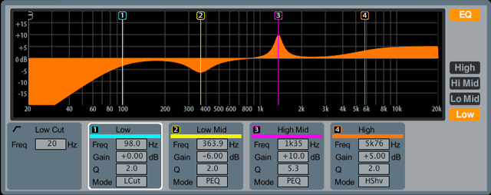
Using all of your Tools: The science and application of Male/Female hearing in iem

Slide 4
Contents
Opening Discussion
Science
Application & Discussion
Conclusion
Questions

Slide 5
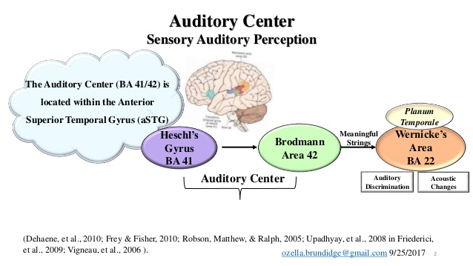
Primary audio cortex
Otoacoustic Emissions
Auditory Brainstem response
Estrogen as a processor
The Super Nerd Science
Don’t worry it’ll be (kinda) quick ☺
Notes:
Brodmann area (BA) 41 – PAC- Lateralities-
This indicates that males have a much larger activation in the PAC during music than during noise. The PAC was more activated by music than by noise in both men and women. But this difference between the two stimuli was significantly higher in men than in women. On the other hand, a sex difference was detected in the processing of noise, because females activated their PAC significantly more than males.
Lateral Processing: Namely, differences in attention result in a different deactivation of the right prefrontal cortex, which in turn modulates the activation of the PAC and thus explains the sex differences found in the activation of the PAC.
OAE’s are sounds of cochlear origin, which can be recorded by a microphone fitted into the ear canal. They are caused by the motion of the cochlea's sensory hair cells as they energetically respond to auditory stimulation. OAEs are faint sounds that originate within the cochlea and are recorded in the ear canal.^{[45]} OAEs are a by-product of the active processes in the cochlea, which are necessary for hearing. Measurement of OAEs has added a new dimension to clinical audiometry
"It turns out that estrogen plays a dual role," says Pinaud. "It modulates the gain of auditory neurons instantaneously, and it initiates cellular processes that activate genes that are involved in learning and memory formation.”
Sound impulses travel the auditory pathway faster in women. Numerous studies have established that latencies of the various ABR waves, particularly wave V, are consistently shorter in women.^{[32,36,37,38,39,40]}

Slide 6
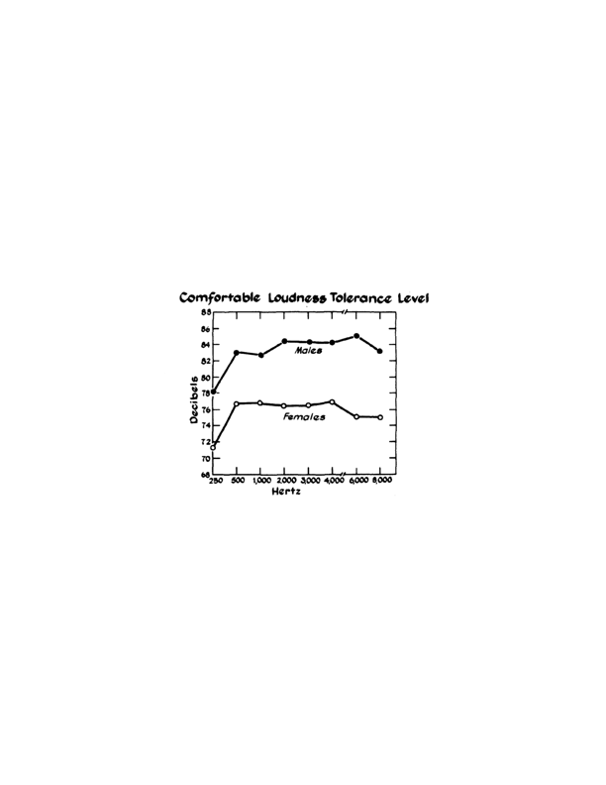
The Playing Field
Comfortable loudness curves for females and males, reproduced from McGuinness, 1974.
Notes:
Elliott (1971) reported similar findings in
children as young as 5 years old.
Their subjects included 25 females and 25 males, all between 19 and 25 years of age, and all with normal hearing. The most comfortable listening level for females was 36.2 decibels; for males it was 42.1 decibels, or about 6 decibels louder. This difference was significant (p = 0.009). In other words, males preferred speakers to speak about 6 decibels louder, on average, compared to the loudness pre- ferred by females. Likewise, the acceptable background noise level for females was 24.8 decibels, while for males it was 31.7 decibels, or about 7 decibels louder. This difference was, again, significant (p = 0.007). To express this finding another way: males tolerated significantly louder background noise than females did. -Men have a higher threshold of hearing than women (-6 db), and a lack of high frequency response while being outstanding on placing sounds in the horizontal and vertical planes thought to be caused not just by hormonal factors, but also evolutionary. They also have a higher sensitivity to the lower end of the spectrum, as demonstrated in the chart. Men cal also deal with up to +6db of background noise, where women are distracted at 6 db lower.
-Lower hearing threshold ( -6 below men) Women process audio information at a faster rate than men due to the estrogen in our bodies, which means women are able to hear and process more audio information quickly, ABR. We are more sensitive to high end, but lack information in the 1-2k range. Lower sensitivity to low end. Also are less accurate in measuring approaching audio, usually measured too soon, but is a survival evolutionary trait based on being more predated than men.
"Now it is clear that estrogen is a key molecule carrying brain signals, and that the right balance of hormone levels in men and women is important for reasons beyond its role as a sex hormone,”
Documented sex differences include better outer hair cell function and more prominent auditory brainstem response in women. Women also have lower rates of hearing loss than men, and men also experience declines in hearing more rapidly than their female counterparts.
"It turns out that estrogen plays a dual role," says Pinaud. "It modulates the gain of auditory neurons instantaneously, and it initiates cellular processes that activate genes that are involved in learning and memory formation."

Slide 7
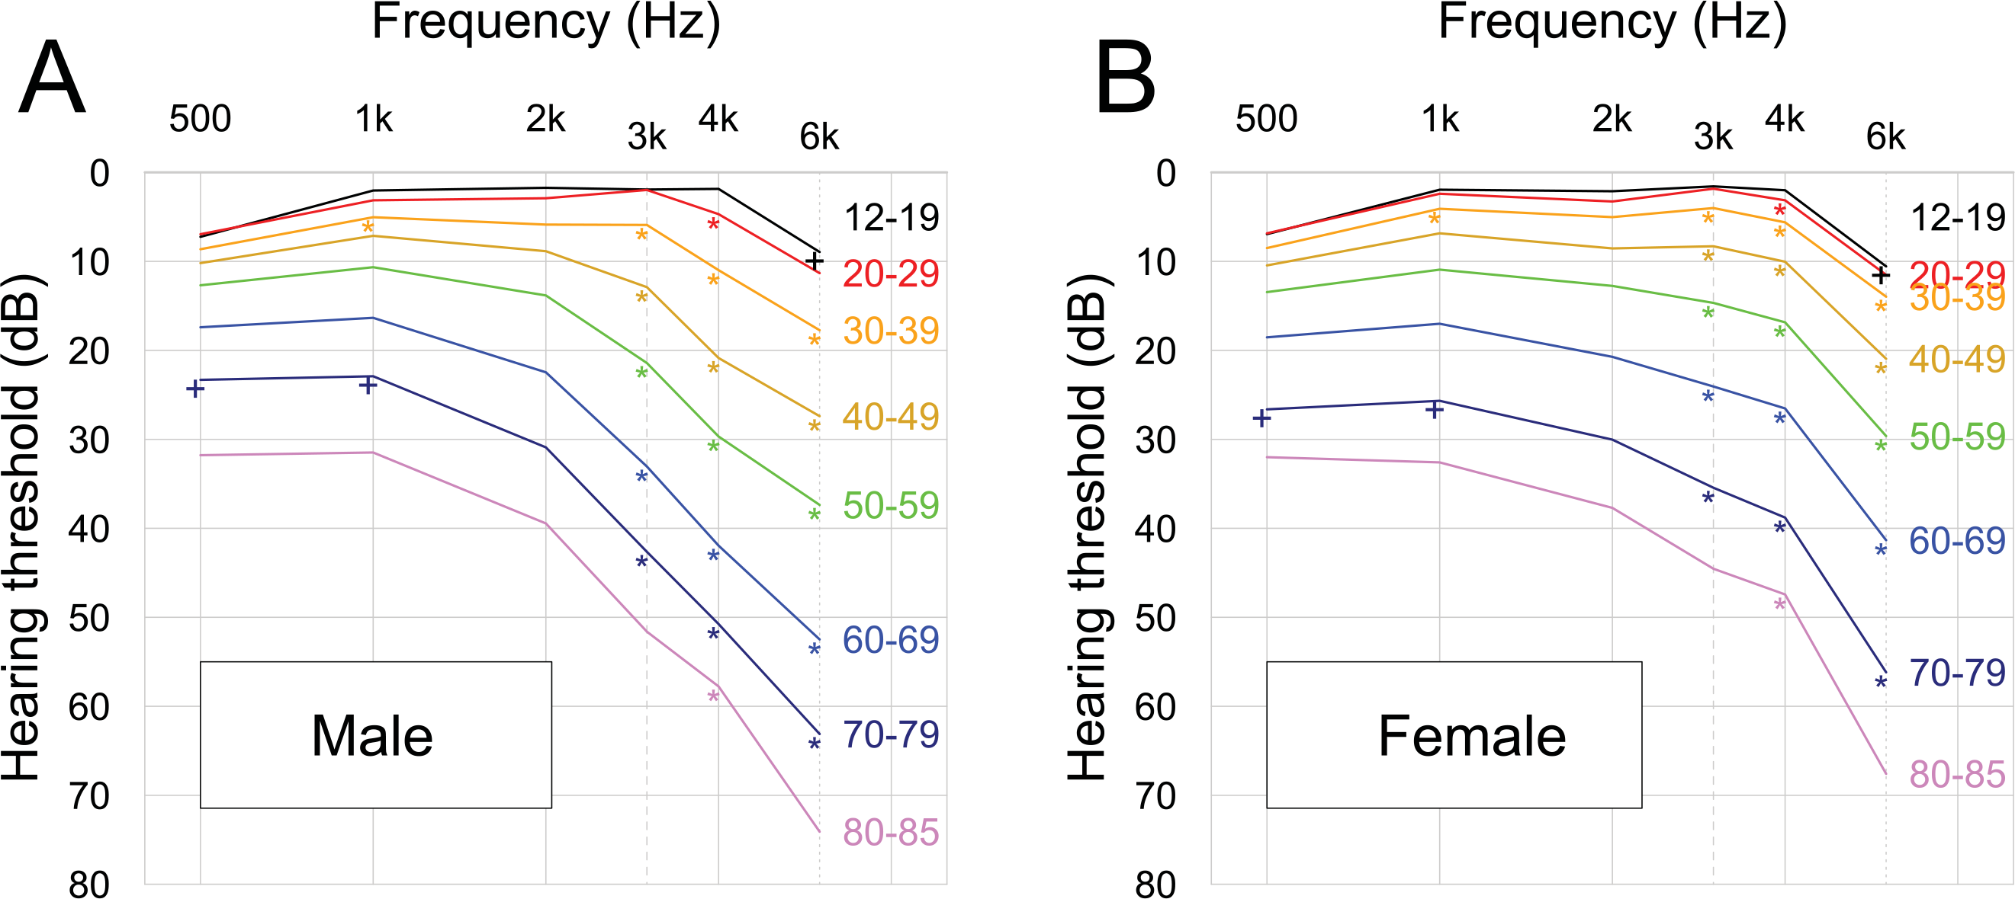
Natural frequency response
Age- and Gender-Related Mean Hearing Threshold in a Highly-Screened Population: The Korean National Health and Nutrition Examination Survey 2010–2012 (2016)-Byun, Kim, Park, Shin
Park YH, Shin SH, Byun SW, Kim JY (2016) Age- and Gender-Related Mean Hearing Threshold in a Highly-Screened Population: The Korean National Health and Nutrition Examination Survey 2010–2012. PLOS ONE 11(3): e0150783.
Notes:
showed gender differences at hearing thresholds of 3 kHz, 4 kHz, and 6 kHz in a highly-screened population. The most significant gender difference in relation to hearing threshold was observed at 4 kHz. The hearing thresholds at the tested frequencies worsened with increasing age.
Rogers and colleagues (2003) measured subjects’ most comfortable listening level and subjects accept- able background noise level. Their subjects included 25 females and 25 males, all between 19 and 25 years of age, and all with normal hearing. The most comfortable listening level for females was 36.2 decibels; for males it was 42.1 decibels, or about 6 decibels louder. This difference was significant (p = 0.009). In other words, males preferred speakers to speak about 6 decibels louder, on average, compared to the loudness preferred by females. Likewise, the acceptable background noise level for females was 24.8 decibels, while for males it was 31.7 decibels, or about 7 decibels louder. This difference was, again, significant (p = 0.007). To express this finding another way: males tolerated significantly louder background noise than females did.
In the Baltimore Longitudinal Study on Aging, hearing ability at most ages and frequencies tested was found to decline more than twice as fast for men compared with women (17), particularly at higher frequency regions

Slide 8
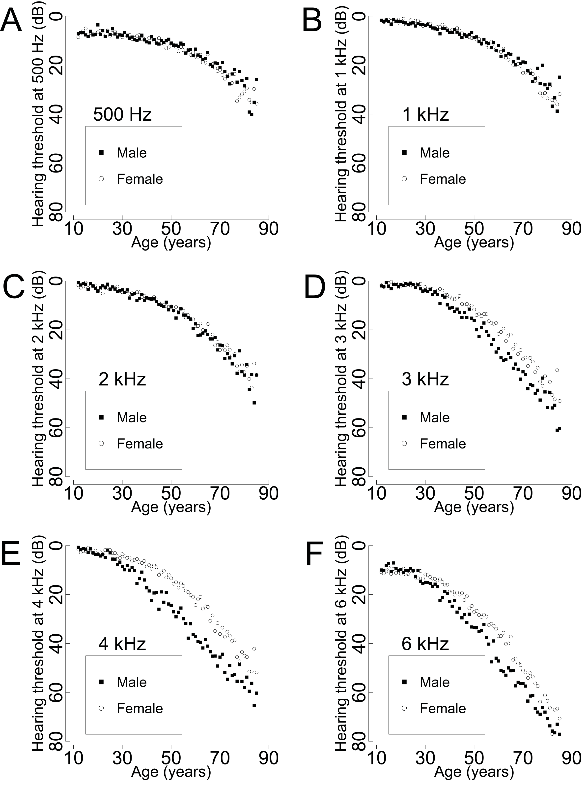
Frquency Response- detailed
Park YH, Shin SH, Byun SW, Kim JY (2016) Age- and Gender-Related Mean Hearing Threshold in a Highly-Screened Population: The Korean National Health and Nutrition Examination Survey 2010–2012. PLOS ONE 11(3): e0150783.
Notes:
Park YH, Shin SH, Byun SW, Kim JY (2016) Age- and Gender-Related Mean Hearing Threshold in a Highly-Screened Population: The Korean National Health and Nutrition Examination Survey 2010–2012. PLOS ONE 11(3): e0150783. https://doi.org/10.1371/journal.pone.0150783
https://journals.plos.org/plosone/article?id=10.1371/journal.pone.0150783

Slide 9
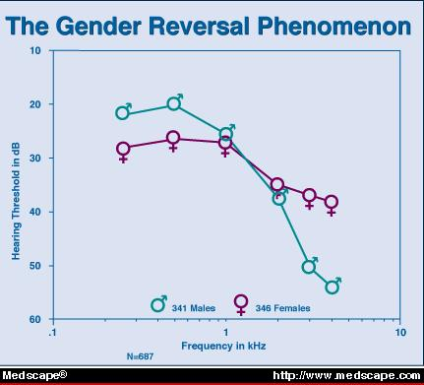
Specific Differences outlined In Hearing loss
The gender reversal phenomenon. Average audiograms of 341 males and 346 females in age range 50 to 89 years. Adapted with permission from J Am Acad Audiol (1993;4:42-49), Copyright © 1993, American Academy of Audiology.
Notes:
The better pure-tone audiometry thresholds of women at all ages at frequencies above the 1000- to 2000-Hz range are paradoxically accompanied by a "gender reversal" in which women have a poorer capacity to hear at frequencies below 1000 to 2000Hz^{[12,14,15,18]} than do men (Fig. 2). The effect is true prior to advanced stages, and it increases with both age and degree of hearing loss. The increased rate of low-frequency hearing loss in women may be due to metabolic presbycusis (i.e., biologic factors). All of this scientific data is just a way to define the truth differences in male and female hearing. It’s not that anyone is better, rather, different in how we process and receive audio information. Understanding these differences will allow you to add more color in depth into your artists mix without stepping on their own aural spectrums.
A greater incidence^{[31]} and prevalence^{[12]} of low-frequency hearing loss have been demonstrated in women compared with men. Several biologic factors have been studied to determine a gender basis for differences in hearing and hearing loss.

Slide 10
Put it all together More simply And how to use it

Slide 11
Adding it into work
Request a hearing test for your artist so you know what they’re hearing, including any holes that could be hindering your mix.
Get your own hearing tested so you can know any anomalies in your hearing and truly know what you are hearing.
Use this knowledge to address you mix accordingly. Male mixing for a woman? She’ll need to hear significantly less high end than you think. Female mixing for a male? Hearing something a little barky and can’t put your finger on it? Try that 1-2k we have a little dip in.
Males understand that women have a much lower volume need than you think, around 6db lower
Women remember the same, if you think it’s screaming loud for you it’s probably just right for him.

Slide 12
Male differences outlined
-Increased sensitivity to sound localization (i.e sound placement/pan)
Higher Hearing Threshold than women by 6-8db
More sensitive to low end/ below 1k/2k
Less sensitive to high end with a steeper dip at 4k
Able to tolerate more background noise before distraction
Better able to anticipate the arrival of an object based on sound
Loses hearing much more quickly than women

Slide 13
Female differences outlined
Increased overall sensitivity to sound
6-8db lower hearing threshold than men
More sensitive to high frequencies, above 1k/2k
Less sensitive to lower frequencies, particularly 1k/2k
Able to process audio information more quickly
Loses hearing significantly slower than males
Is distracted by background noise at 6-8db lower than a man
Estrogen allows different audio processing, faster ABR

Slide 14
Works cited
Please Contact me for a Complete List of References

Slide 15

questions

